Slide 1
Family Meeting
By: Stephanie Snoddy
Email: Stephanie.snoddy@cms.k12.nc.us
Website: http://ssnoddy.weebly.com

Slide 2
Purpose of Meeting
Discussion and clarification of 3 things
Present: Where we are
Future: Where we need to be
Plan: What we need to do to get there

Slide 3
Where We Are Now
Attendance: Tardies and Absences
Literacy:
Middle of Year Expectation: All letters/sounds,30 on beginning sounds (FSF), 20 on stretching words (PSF), 17 on blending nonsense words (NWF), 60 snap words, Level C (TRC)
http://www.readinga-z.com/books/leveled-books/book/?id=1824
Percentage on grade level: 16/18=88%, 12/18 = 66% green, 5/18 = 27%
3 sentences with punctuation, spacing, snap words, sounds in words, capitalization
Math:
Counting aloud to 100: 44%
Counting objects to 15: 50%
Solving simple story problems: Addition: 50%

Slide 4
Future: Where We Need to Be
Attendance: On time and present
End of Year Literacy Expectations:
100 snap words, 40 on stretching words (PSF), 28 on blending nonsense words (NWF), reading a level D (TRC)
http://www.readinga-z.com/books/leveled-books/book/?id=950
4 or more sentences with spacing, capitalization, sounds, snap words, punctuation (narrative, informative texts)
End of Year Math Expectations:
Number sense: Counting aloud, objects, reading/writing numbers
Solving simple addition and subtraction story problems
Addition and subtraction fluency within 5

Slide 5
Literacy Plan: What We Need to Do
At school:
Reading and Writing: Mini-lesson, Independent work
Small group instruction from Ms. Snoddy daily
Guided Reading
Strategy groups: Blending, word families, making words, stretching
Small group from Tutors on Thursdays and Fridays
Small group pull-out on Wednesday for snap words
Small group pull-out from TA daily for reading mastery
20-30 minutes independent reading daily/Raz-kids.com

Slide 6
Literacy Plan continued…
At home:
Read to your child every night and sign the reading log
Pointing to each word, looking for snap words/spelling words
Use strategies bookmark
http://youtu.be/FjJD1UDwVKg
Let them read to you or independently (depending on level)
Study snap words/spelling words
Take-home packet
Raz-kids.com
Log-in from home
Daily journal to practice writing skills

Slide 7
Math Plan
At school:
Math Investigations mini-lessons
Math workshop activities
Math activities to practice skills needed
Small group with Ms. Snoddy daily
Small group with 2 Teacher Assistant 3-5 times a week
Computer: Dreambox.com activities
Log-in from home

Slide 8
Math Plan continued…
At home:
Computer: Dreambox
Integrate addition/subtraction into daily activities
Label teen numbers around the house
Solve story problem or addition/subtraction for privileges
Practice counting aloud to 100 on the way to/from school
Count out fruit to put in the basket at the grocery story

Slide 9
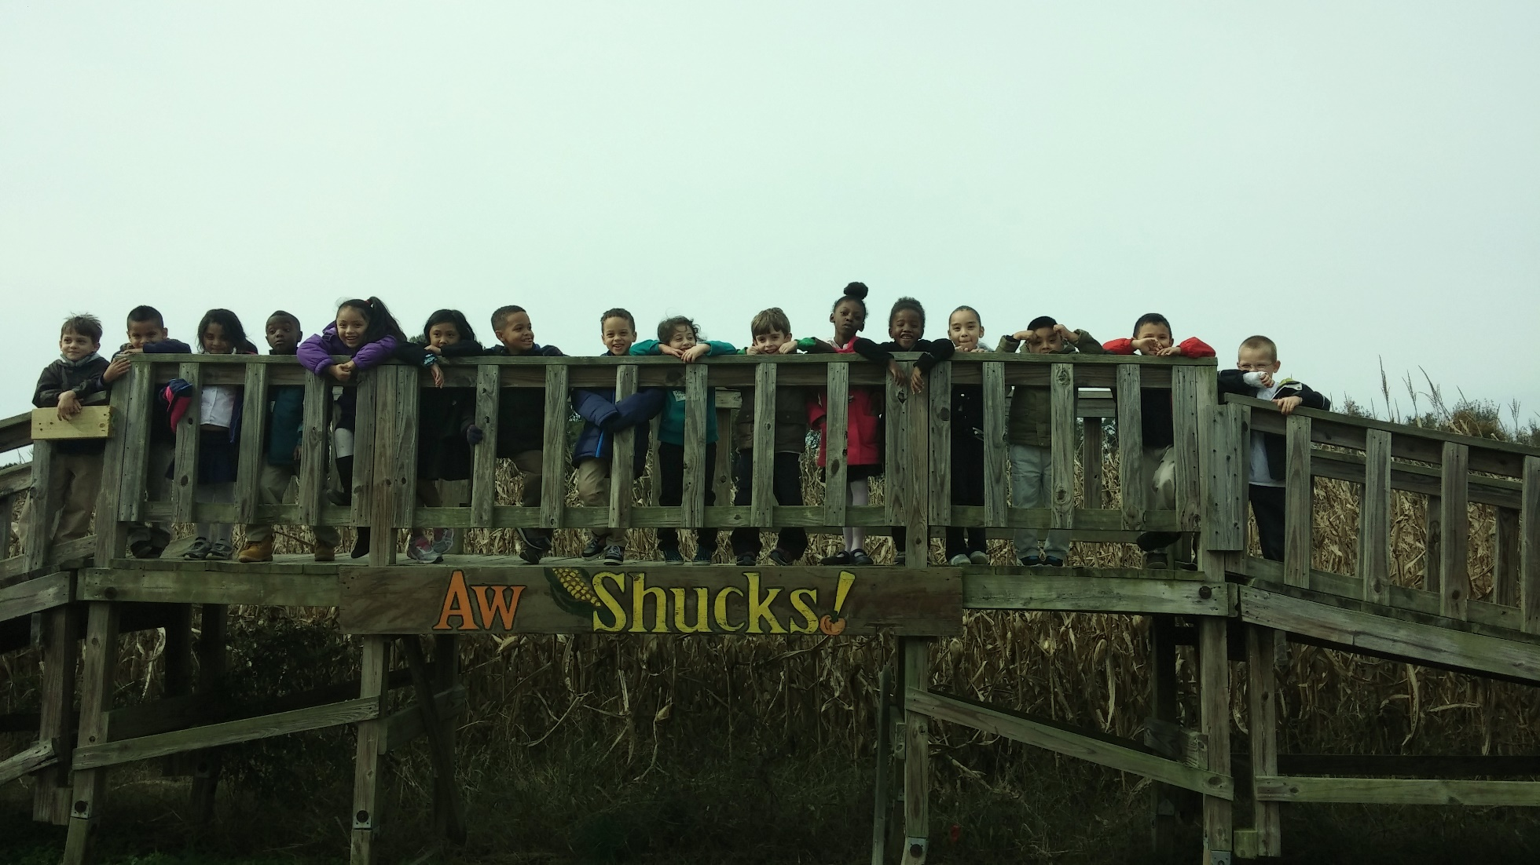
Questions?

